Slide 1

K14T01-Team1-Team Assignment#10
Team member:
Duong Nguyen
Hien Nguyen
Manh Nguyen
Mung Nguyen
Binh Huynh

Slide 2

Agenda
Introduction
Employee Satisfaction Measurement
Employee Satisfaction Report
Recommendations

Slide 3

Introduction
To specify the method to analysis employee survey data
To specify the strengths and weaknesses in this survey
To shows the areas for improvement for the survey
To suggest recommendations that would you make to improve the survey

Slide 4
Background
The key aspects of employee satisfaction,
Job satisfaction
I am currently looking for another job outside of ABC Systems
I would recommend ABC Systems to friends as a great place to work
I take pride in my work
Environment
I am provided with opportunities to broaden my skills and knowledge
My department is a great place to work
ABC Systems is a great place to work
My project is a great place to work
I have the tools and resources that I need to get my job done

Slide 5
Background - 2
Communication
I feel informed about changes that affect me
There is cooperation between the departments in the company
I have access to the information that I need to do my job well
I know how my work contributes to the success of ABC Systems
Career promotion
I see career growth and advancement opportunities for myself at ABC Systems
Recognition
I am empowered to make decisions
My opinions are valued by my project team
Training and development
I have had the training I need to get the job done

Slide 6
Employee Satisfaction Measurement
Collect satisfaction index data based on 6 key aspects that is provided
Calculated by the total number % (Strongly Agree and Agree) at each of statement in key aspect.
The satisfaction index of the key aspect is considered positive when more than 65%

Slide 7
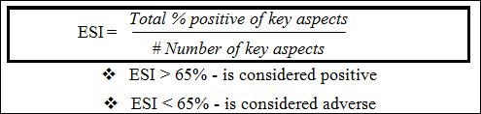
Employee Satisfaction Measurement - 2
Calculates employee satisfaction index (ESI) in ABC System

Slide 8
Employee Satisfaction Report
The overall in year 2010,
The satisfaction index of job satisfaction factor is 57% positive (< 65% in benchmark)
47% of employees are looking another job outside of ABC System.
The overall, job satisfaction level at ABC System is low.
The satisfaction index of environment factor is 46% positive (<65% in benchmark).
The environment satisfaction level is low at ABC System.

Slide 9
Employee Satisfaction Report
46% of employees can see opportunities for career development comes from ABC System.
The satisfaction index of career promotion factor is low at ABC System (46% actual < 65% in benchmark).
The satisfaction index of communication factor is 41% (<65% in benchmark).
Compared with the benchmark, most employees are least satisfied with communications at ABC System.

Slide 10
Employee Satisfaction Report
The satisfaction index of recognition factor is 46% (<65% in benchmark).
This means that 46% of employees feel that they are recognized by their coworkers and their managers.
However, the satisfaction index of recognition factor is still low at ABC System.
49% of employees are satisfied with the training and development in ABC System.
However, the satisfaction index of training factor is still slow at ABC System (<65% in benchmark) when we compare with the benchmark.

Slide 11

Employee Satisfaction Report
49% of employees are satisfied with the training and development in ABC System.
However, the satisfaction index of training factor is still slow at ABC System (<65% in benchmark) when we compare with the benchmark.
The Employee Satisfaction Index in 2010,
ESI is 47% (< 65% in benchmark) – most employees are not satisfied with ABC System.

Slide 12
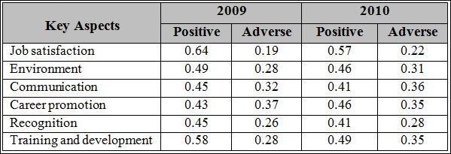
Employee Satisfaction Report
The employee satisfaction trend from 2009 to 2010,

Slide 13
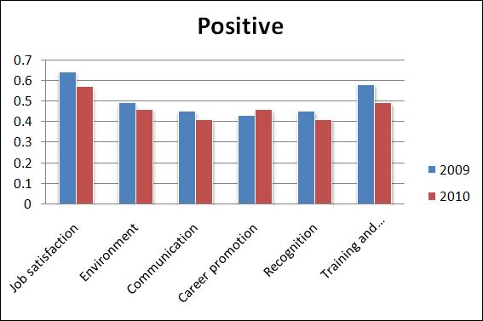
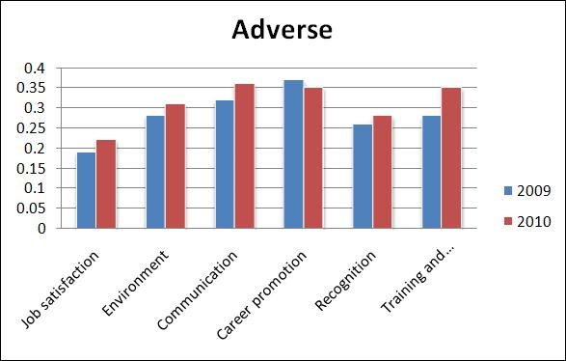
Employee Satisfaction Report
The employee satisfaction trend from 2009 to 2010,
The positive is decreased from 2009 to 2010
The positive is decreased from 2009 to 2010
The Employee Satisfaction Index in 2009, ESI = 51% (> 47% in 2010)
→ The employee satisfaction is increased from 2009 to 2010

Slide 14
Recommendations
Based on the above analysis, the areas for improvement for the survey is: (all key aspects)
Job Satisfaction
Environment
Communication
Career Promotion
Recognition

Slide 15
Recommendations
We need to classify statements in the areas (key aspects).
The survey needs more than 2 statements into area, the employee can be reflect employee satisfaction more.
In current, the survey has only 6 areas. We can add some others area, such as:
Benefit
Management
Work Life
Etc.

Slide 16
Thanks for listening

